Slide 1
Values/Personality/ Character
Substantiators (RTB)
Legacy
Heritage
PoP
Stock options
Locally Made in Chennai
Competitive pricing
Robust yet royal
Brotherhood
Brand Mantra
Legacy, Royal feeling, unique motorcycling experience
Accessible
Updated with new norms
Oldest active motorcycle brand
Exports around the world
24 hr Roadside assistance
Big Engines at the lowest prices
Peculiar Exhaust note
Distinctive design
Timeless Design Philosophy
Unmatched Customer experience in the segment
Globally renowned
Skilled workers
PoD
in manufacturing, sales and services
Executional Properties/ Visual Identity

Slide 2
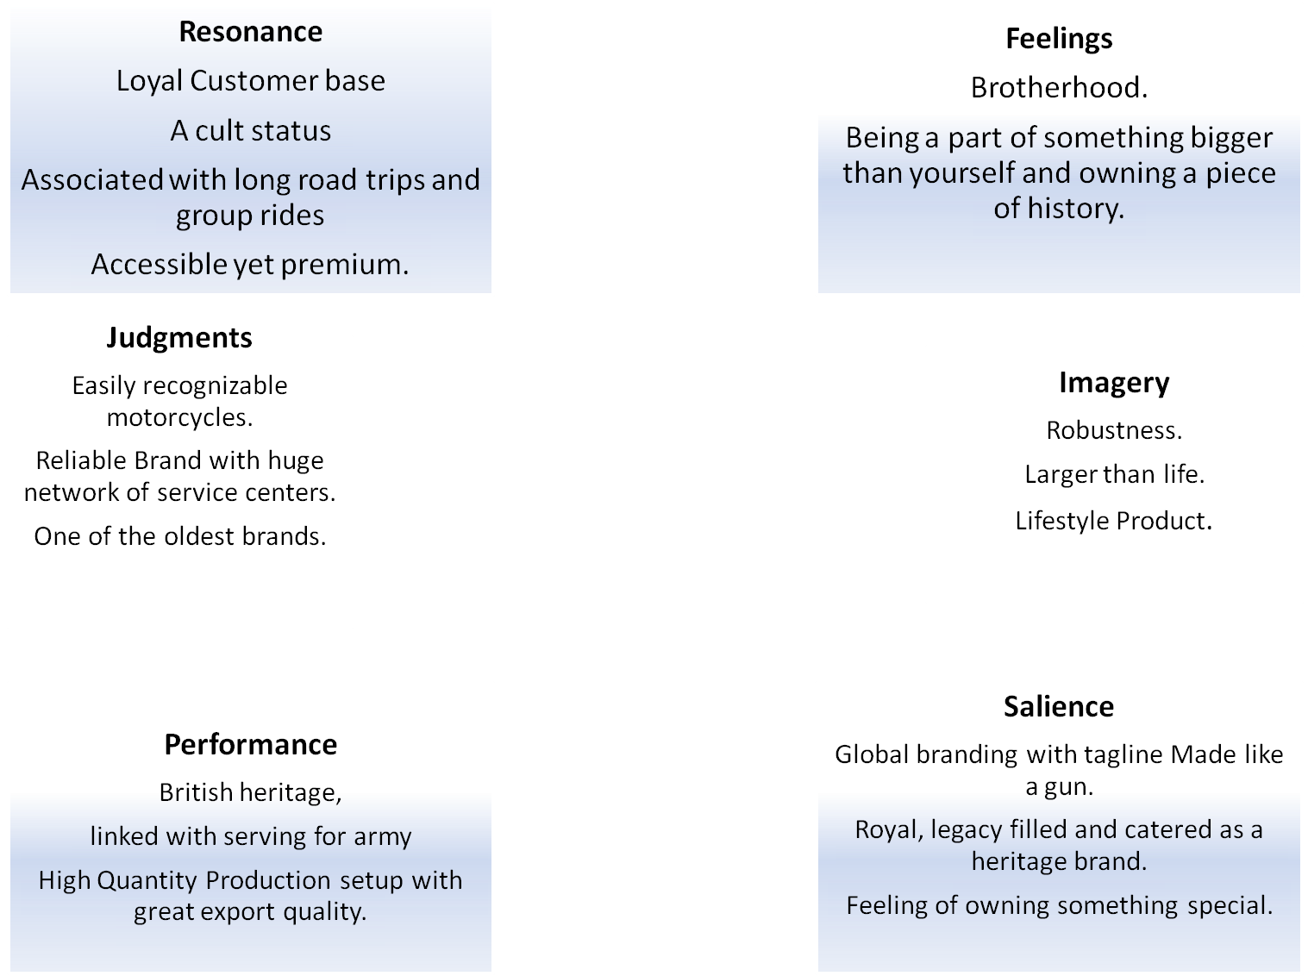

Resonance
Judgments
Feelings
Performance
Imagery
Salience

